Slide 1
Using A Debugger

Slide 2
Ways To Find Program Errors
Include print statements in your program to view or watch program execution (often brute force)
Back track - Find the point where you think the error occurred and then trace back through the program
Explain your code to someone else
Write a unit test
Use a debugger
Designing Classes

Slide 3
What is a Debugger?
a program to run your program and analyze its run-time behavior
a debugger lets you stop and restart your program, see contents of variables, and step through it
Designing Classes

Slide 4
Why Use A Debugger?
Saves you time when programming
  Faster way to find program bugs than printing out variables
Watch a program execute while it is running
  Watch variables or test conditions in your code
Designing Classes

Slide 5
Using a Debugger
Debuggers can be part of your IDE (NetBeans) or separate programs
Three key debugging concepts:
  Breakpoints
  Single-stepping through code
  Inspecting variables
Designing Classes

Slide 6
Using a Debugger
Breakpoint
  A breakpoint is a marker that you can set to specify where execution should pause when you are running your application in the IDE's debugger.
  Breakpoints are stored in the IDE (not in your application's code) and persist between debugging sessions and IDE sessions.
Debugging Programs

Slide 7
Using A Debugger
Execution is suspended whenever a breakpoint is reached
In a debugger, a program runs at full speed until it reaches a breakpoint
When execution stops at a breakpoint, one may:
  inspect variables
  step through the program a line at a time
  or, continue running the program at full speed until it reaches the next breakpoint
Designing Classes

Slide 8








Debugging Icons
 | Debug Project
 | Finish Debugging Session
 | Pause
 | Continue
 | Step Over (Resumes execution until it reaches the next line of the current source file. If the source line contains a call, executes the entire routine without stepping through the individual instructions.)
 | Step Over Expression (Executes one method call in an expression and will move to the next expression)
 | Step Into (Executes one method call in a source line)
 | Step Out (Executes one source line)
 | Run To Cursor
Designing Classes

Slide 9
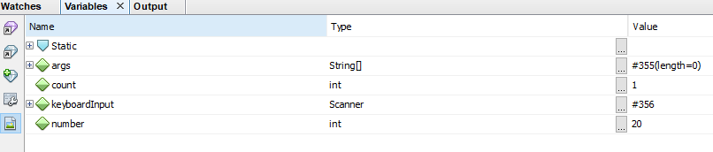
Variable Window
One may set a breakpoint to watch your variables
A variable window will appear and allow you to look at the particular values of various variables
Debugging Programs

Slide 10
Watch Windows
Debugging Programs

Slide 11
Using A Debugger
When program terminates, debugger stops as well
Breakpoints stay active until you remove them
Designing Classes

Slide 12
Using NetBeans Debugger
NetBeans has a YouTube video that explains how to use the Netbeans Debugger
https://www.youtube.com/watch?v=2Z9B8wYhKWw
Debugging Programs

Slide 13
Using A Debugger

